Slide 1
Analytical Methods : Time Series
Mar’10
Sankalp Mathur (sankalp.mathur@gmail.com)

Slide 2
Topics
Time Series Basics
Components and Decomposition
Analysis of Trend Component
Analysis of Seasonal Component
Modeling
Auto Regressive Modeling
Moving Average Modeling
Auto Regressive Moving Average Modeling
Auto Regressive Integrated Moving Average Modeling

Slide 3
Time Series
Time Series is a sequence of observed values ordered in time
If a single value is being observed at multiple points in time then it is a univariate time series else it is a multivariate time series
Basic assumption of time series modeling is that past trends would continue in the future
System acts as a black box and captures only “what” and not “why” (Causal effects may not be understood well or available)
Successive instances are statistically dependent (auto-correlation) and TS analyses such dependencies
Decomposition models are the oldest approach followed by Moving average and then exponential smoothing when later it was found out that they are special cases of statistically sound ARIMA process
Typically all TS Models will be used for forecasting

Slide 4
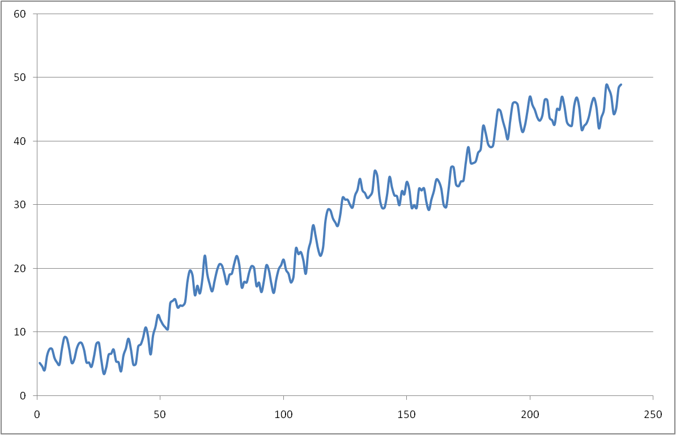
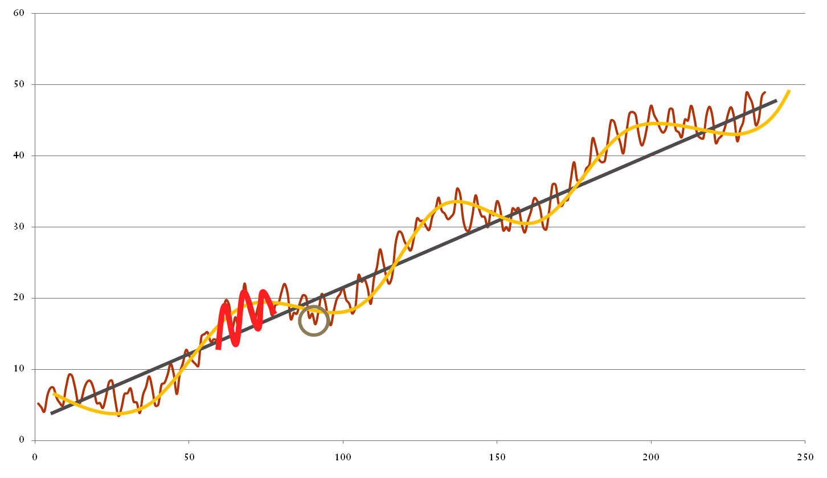
Components and Decomposition
Trend Component– Linear Increasing- T_{t}
Cyclical Component – Sinusoidal - C_{t}
Seasonal Component – Sinusoidal-S_{t}
Y_{t} = T_{t}+C_{t}+S_{t}+ε where Y_{t}’s are realizations of observed values
Random Component – No Shape will work-ε
In most cases data is small and cyclical trend is not observable

Slide 5
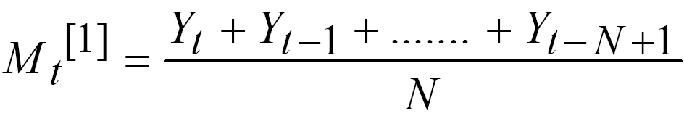
Analysis of Trend Component
There is no proven “automatic” standard technique
Data visualization helps so far as the trend in intuitive (linear, exponential etc.)
Typically data has considerable errors and needs to be “smoothed”
Smoothing means removal of irregularities by certain local averaging
Most common smoothing technique is n-window moving average
In case of large errors (uncommon) distance weighted least square or negative exponentially weighted smoothing can be used
Function needs to be fitted to the trend by removing any non-linearity if it exists in the smoothed data

Slide 6
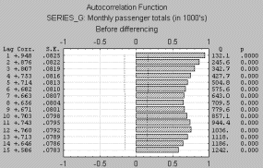
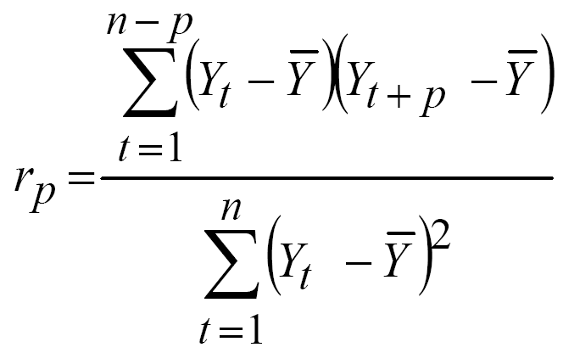
Analysis of Seasonal Component
Seasonality can be defined as the correlation dependency of order k between i^{th} element with i+k^{th} element
k is the lag
Data recorded with insignificant errors can show seasonality visually as a repeating pattern every k element
Can be observed using Auto-Correlation correlograms
Partial Auto Correlation functions shows the picture of serial dependency which could be removed by differencing with k^{th} element

Slide 7
Modeling
Models can have many forms and represent different stochastic processes
3 Broad classes of practical importance are
Autoregressive Models
Integrated Models
Moving Average Models
Combinations of above ideas produce
Auto regressive Moving Average (ARMA)
Auto Regressive Integrated Moving Average (ARIMA)
Auto Regressive Fractionally Integrated Moving Average (ARFIMA)
Other Non Linear Models represent change of variance along time called Autoregressive Conditional heteroskedastic (ARCH) Models
Linear dependence on previous realizations is present in all these methods

Slide 8



Auto Regressive Modeling
Model of order p is where are model parameters c is a constant and ε_{t} is white noise with stats μ , σ²
Constraints :
Roots of the equation must lie within unit circle
Above condition promises stationarity
Parameter estimation is done using Yule-Walker’s equation
For AR(1) i.e. p=1 : First Order Auto Regressive Model
Conceptually equivalent to a linear regression on previous realizations

Slide 9
Moving Average Modeling
This is the most common approach to univariate TS Modeling
Moving average of order q is represented by MA(q)
where μ is the mean of the series, the θ₁, ..., θ_{q} are the parameters of the model and the ε_{t}, ε_{t−1},... are white noises error terms
The value of q is called the order of the MA model
Conceptually equivalent to a linear regression on error terms assumed normally distributed

Slide 10


Auto Regressive Moving Average Modeling
Combination of AR and MA models also called Box-Jenkins Model
ARMA(p, q) refers to the model with p autoregressive terms and q moving average terms
ARMA is appropriate when a system is a function of unobserved shocks as well as its own behavior
If exogenous variables are added then leads to ARMAX model Auto Regressive Moving Average Model with Exogenous inputs

Slide 11

Auto Regressive Integrated Moving Average
This is a generalization over the ARMA model
Applied in cases where the data shows non stationarity but may be differenced to achieve stationarity
Denoted as ARIMA(p,d,q) model where p, d, and q are integers greater than or equal to zero and refer to the order of the autoregressive, integrated, and moving average parts of the model respectively
Used for observable non-stationary process X_{t} with clear trends
Constant Trend – Non Zero Average – d=1
Linear Trend – Linear Growth Behavior – d=2
Quadratic Trend – Quadratic Growth Behavior – d=3

